Slide 1
Selecting the Venue to set up Japanese Ramen Restaurant in Queens, New York
Kean Tat Koh

Slide 2
Problem Statement
Ramen is a noodle soup dish that was originally imported from China and has become one of the most popular dishes in Japan in recent decades. Ramen are inexpensive and widely available, two factors that also make them an ideal option for budget travellers.
Queens is the easternmost of the 5 boroughs in New York city. It is the largest borough geographically and is adjacent to the borough of Brooklyn at the southwestern end of Long Island.
With the large and diverse population at Queens, it provides good business opportunity for any established Japanese Ramen restaurants or chains to set up their business there. However, selecting the appropriate venue to set up the restaurant could be a big problem if no proper analysis is carried out to ensure maximum business potential.

Slide 3
Business Analytic Plan
The borough and neighborhood data for New York City are obtained online, followed by data wrangling and cleaning to get the geographical information (such as geographic coordinates).
By accessing Foursquare API using the geographical information obtained, data below will be extracted and analyzed for eventual business proposal.
Venues at each neighborhood – Data will be filtered and sorted to focus on
Top 100 venues categories in each neighborhood
Top 20 restaurants in Queens.
Neighborhoods with most restaurant
Ramen restaurants in Queens and respective neighborhood.
Machine learning using Kmeans clustering algorithm will be used to find insights about suitable location for restaurant set up

Slide 4
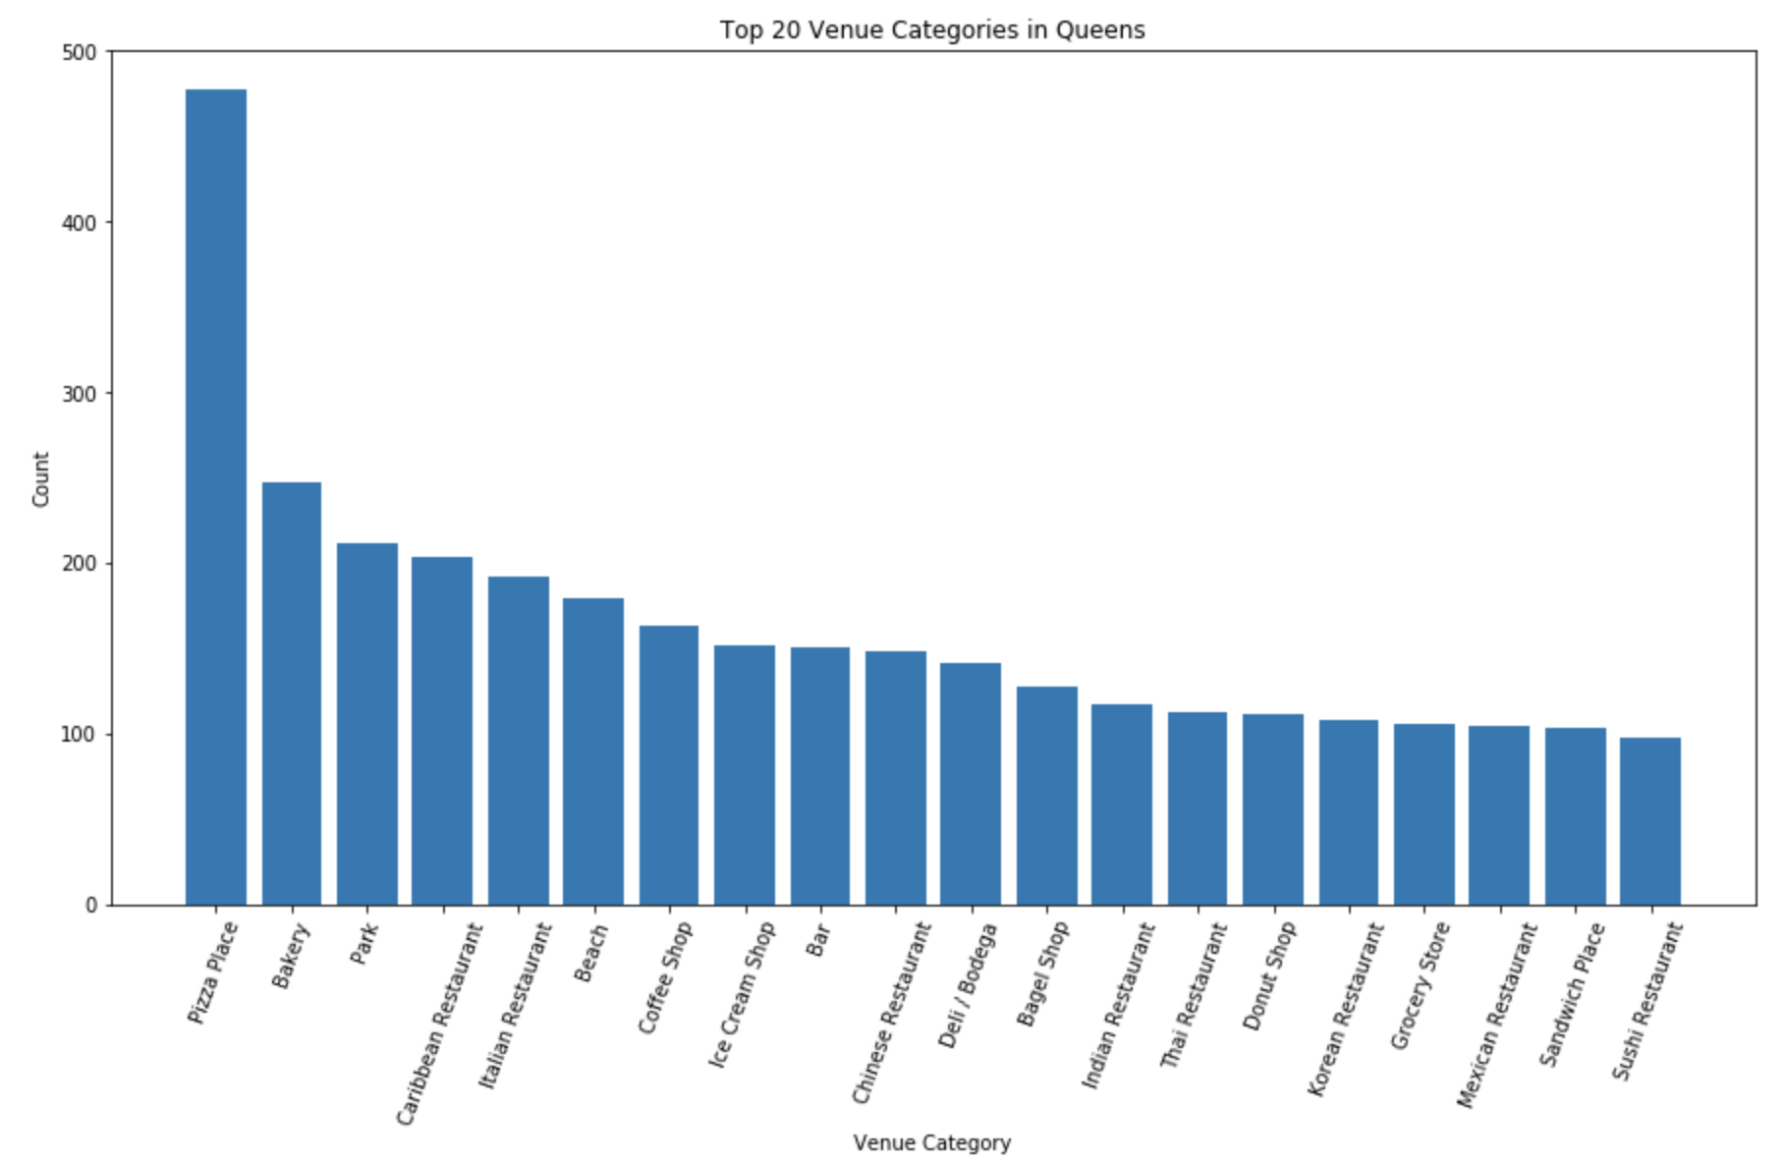
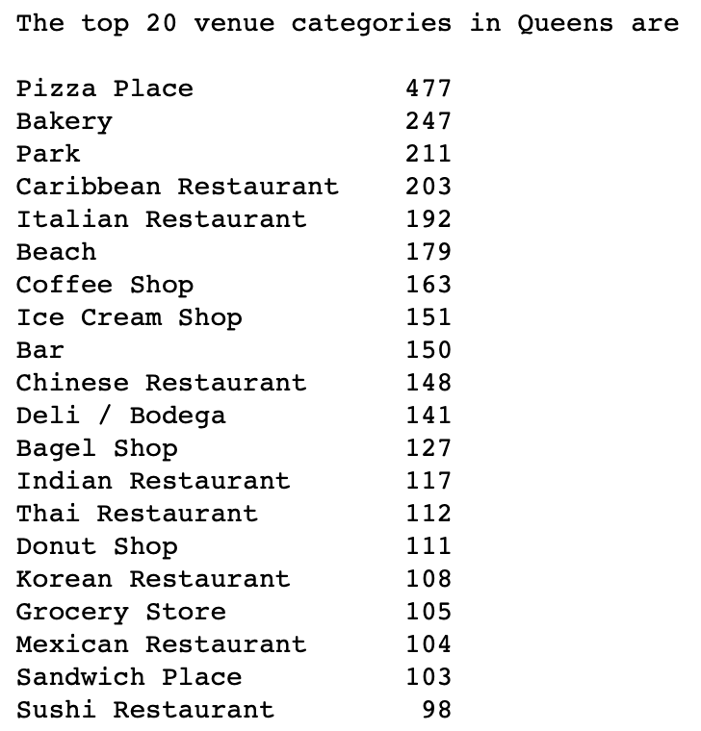
Exploratory Analysis: Top 20 Venue Categories in Queens

Slide 5
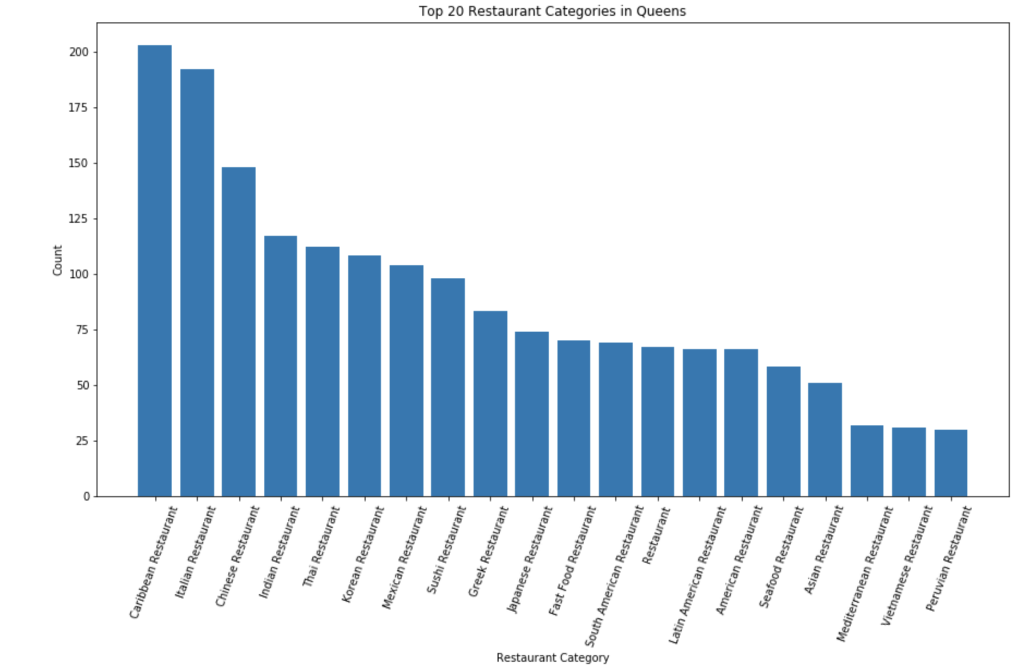
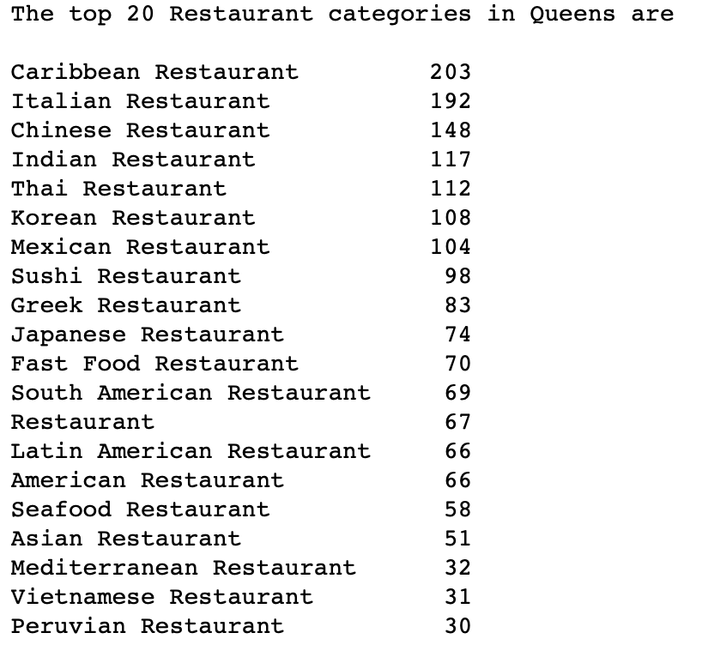
Exploratory Analysis: Top 20 Restaurant Categories in Queens

Slide 6
Exploratory Analysis: Ramen Restaurants in Queens
Low quantity of ramen restaurant in Queens, it is a good choice to set up a new Ramen restaurant there as the competition between Ramen restaurant will be relatively lower compared to setting up a new Caribbean, Italian, Chinese or Indian restaurants.

Slide 7
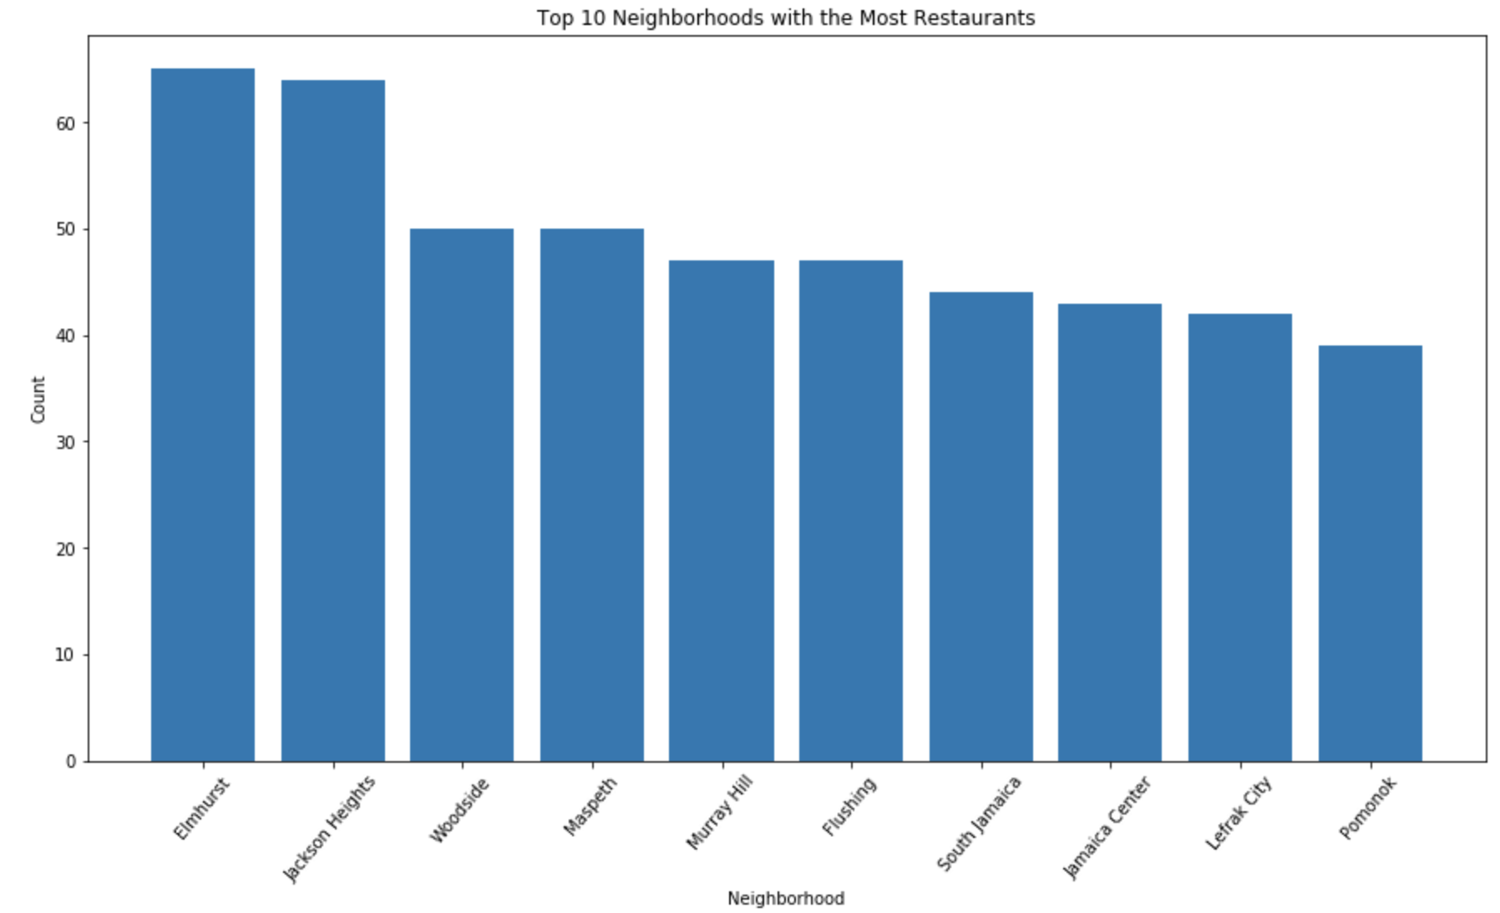
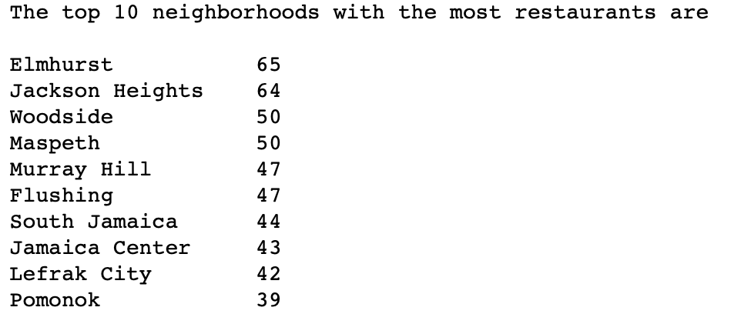
Exploratory Analysis: Top 10 Neighborhoods with Most Restaurant

Slide 8
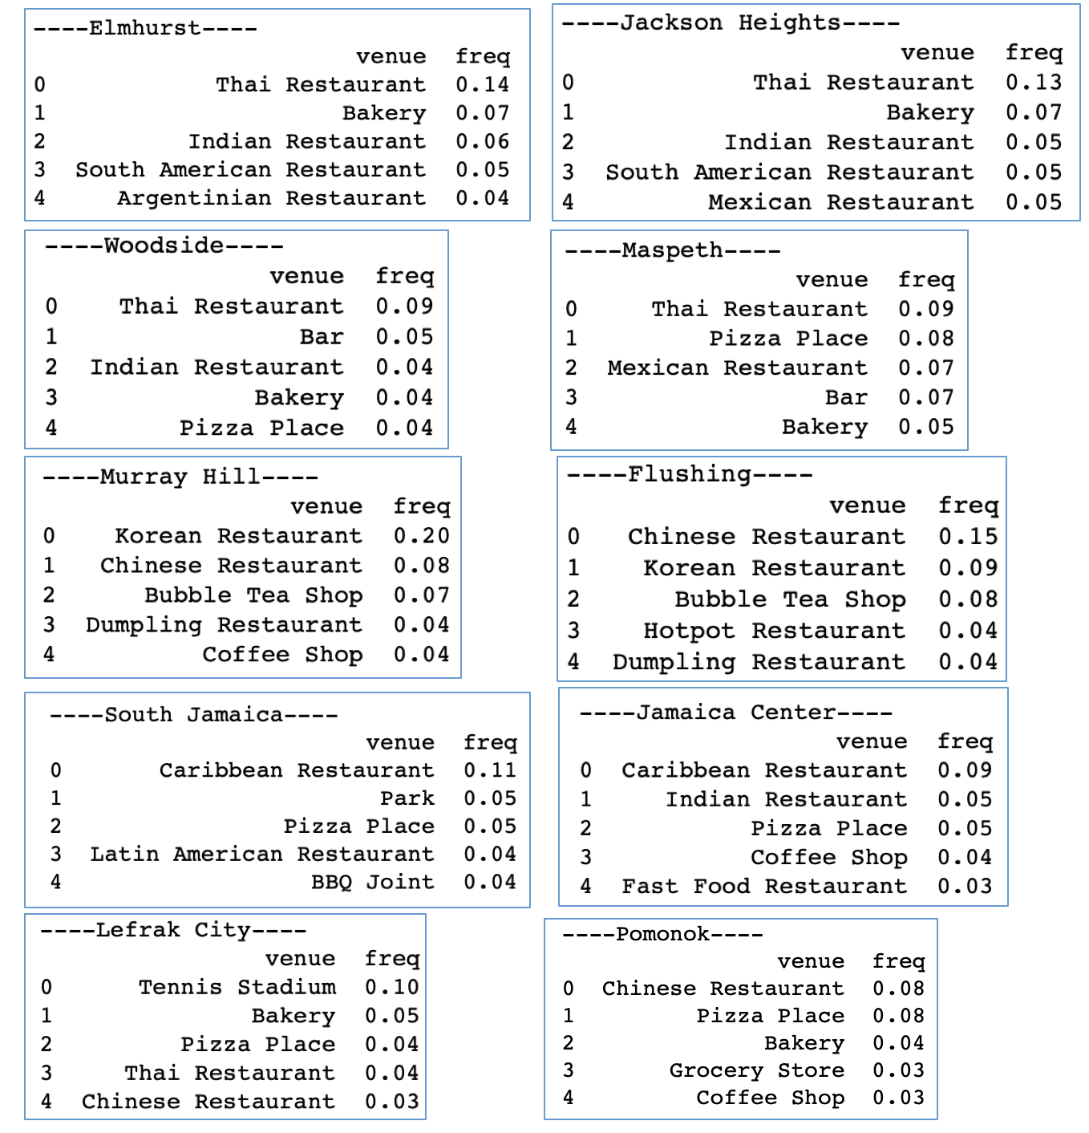
Exploratory Analysis: Top 5 venues in top 10 Neighborhoods with Most Restaurant

Slide 9
Exploratory Analysis
There is no Ramen restaurant in any of these top 10 neighborhoods, thus eliminating the competition concern. Based on research, ramen restaurants are normally available in areas with a large demand for Asian cuisine, probably linked to the higher Ramen popularity by Asians, particularly Chinese, Korean, Hongkie and Taiwanese. The top 5 venues in these top 10 neighborhoods are analyzed, Elmhurst, Jackson Height and Woodside are having Thai restaurants, Indian restaurants and bakery as the top venues, while Murray Hill and Flushing are topping the Korean restaurants, Chinese restaurants and Bubble Tea shops.
As our strategy is to find neighborhoods with high concentration of Asians, Elmhurst, Jackson Height, Woodside, Murray Hill and Flushing are shortlisted based on the type of restaurants listed. Checking on the demographic population in Queens, Flushing, Elmhurst and Woodside are topping the list with highest concentration of Asian. Thus, based on the exploratory analysis, the top 5 recommended venues for setting up new Ramen restaurant in Queens are Flushing, Murray Hill, Elmhurst, Woodside and Jackson Height.

Slide 10
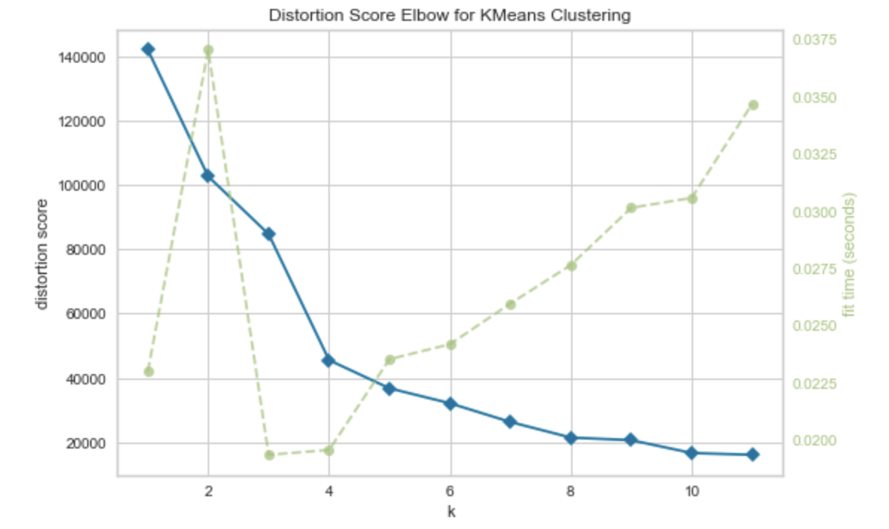
Machine Learning Modeling: Elbow Method to determine number of clusters (k)
k value of 4 is recommended based on the graph, the point which a change in the drop in distortion score is most significantly starting from k =5.

Slide 11
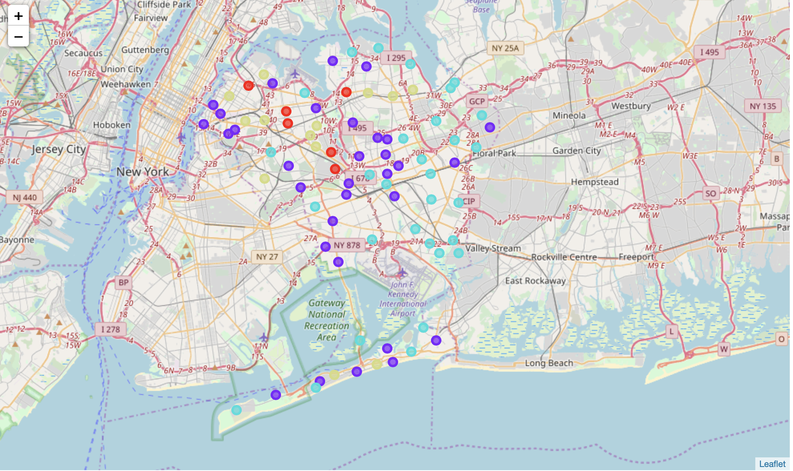
KMeans Modeling: 4 clusters of Neighborhood in Queens

Slide 12
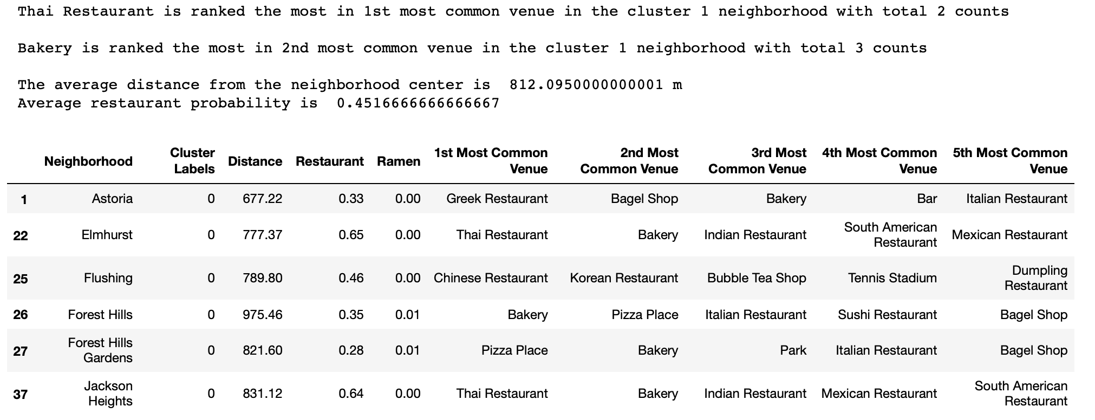
KMeans Analysis: Cluster 1 Summary

Slide 13
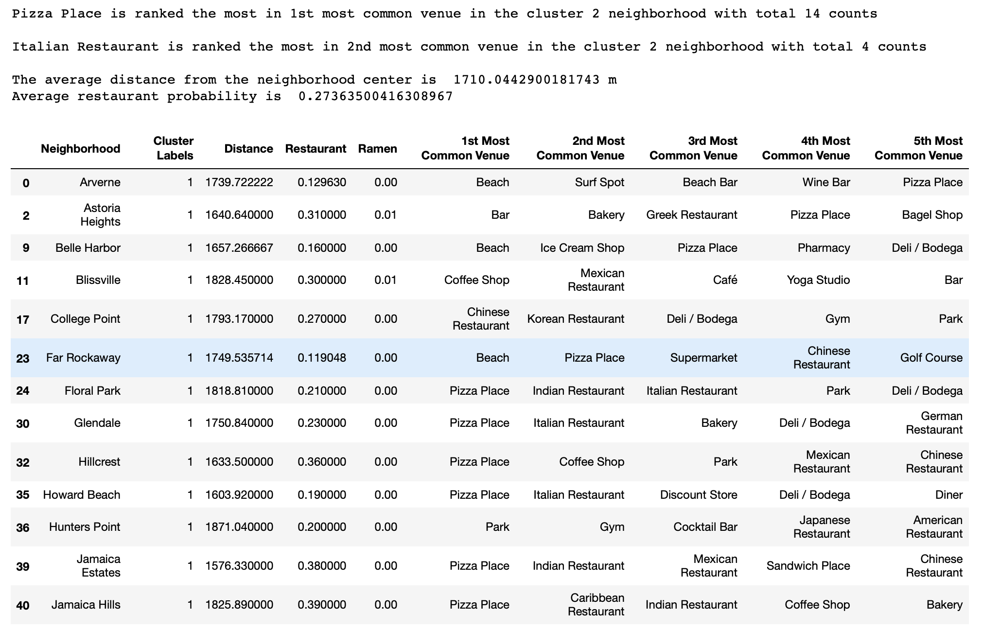
KMeans Analysis: Cluster 2 Summary

Slide 14
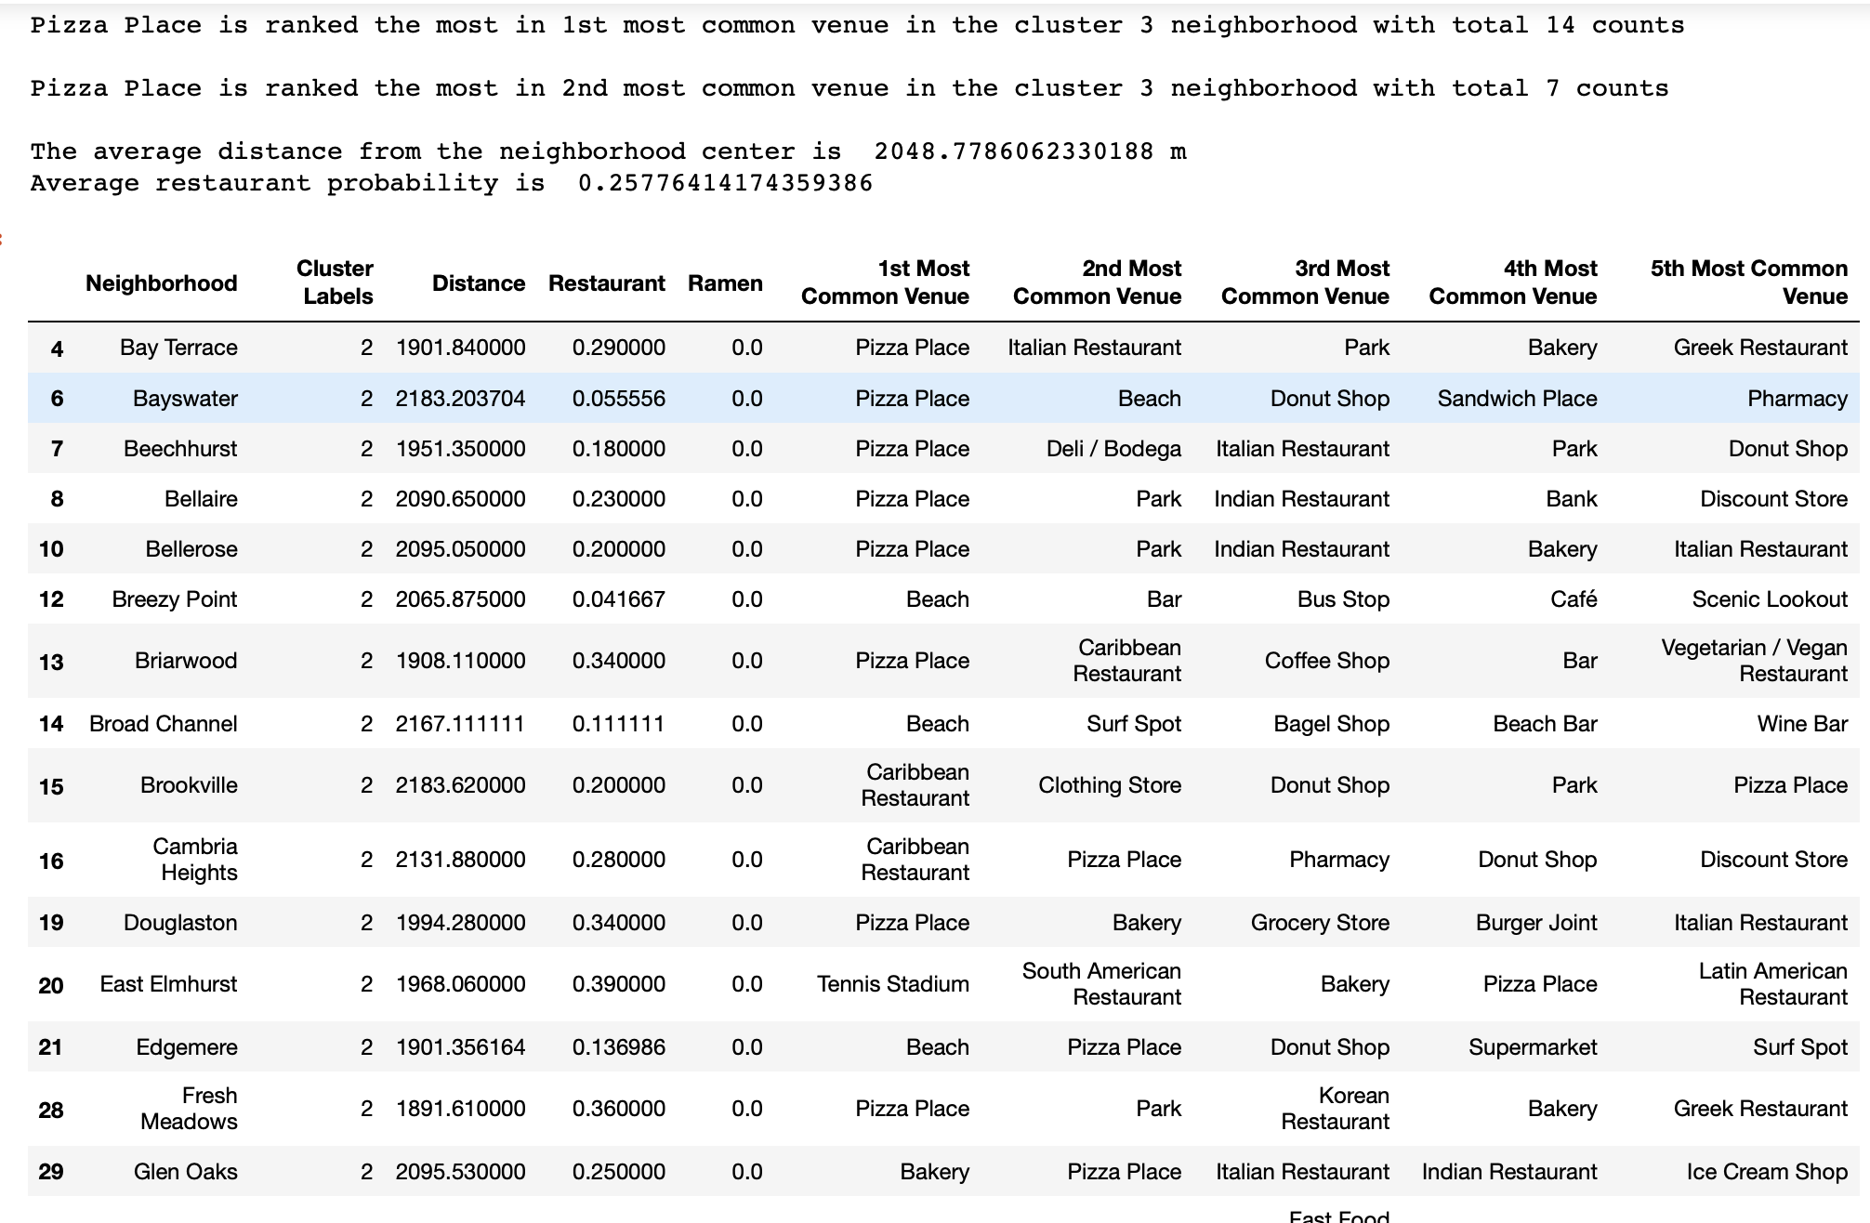
KMeans Analysis: Cluster 3 Summary

Slide 15
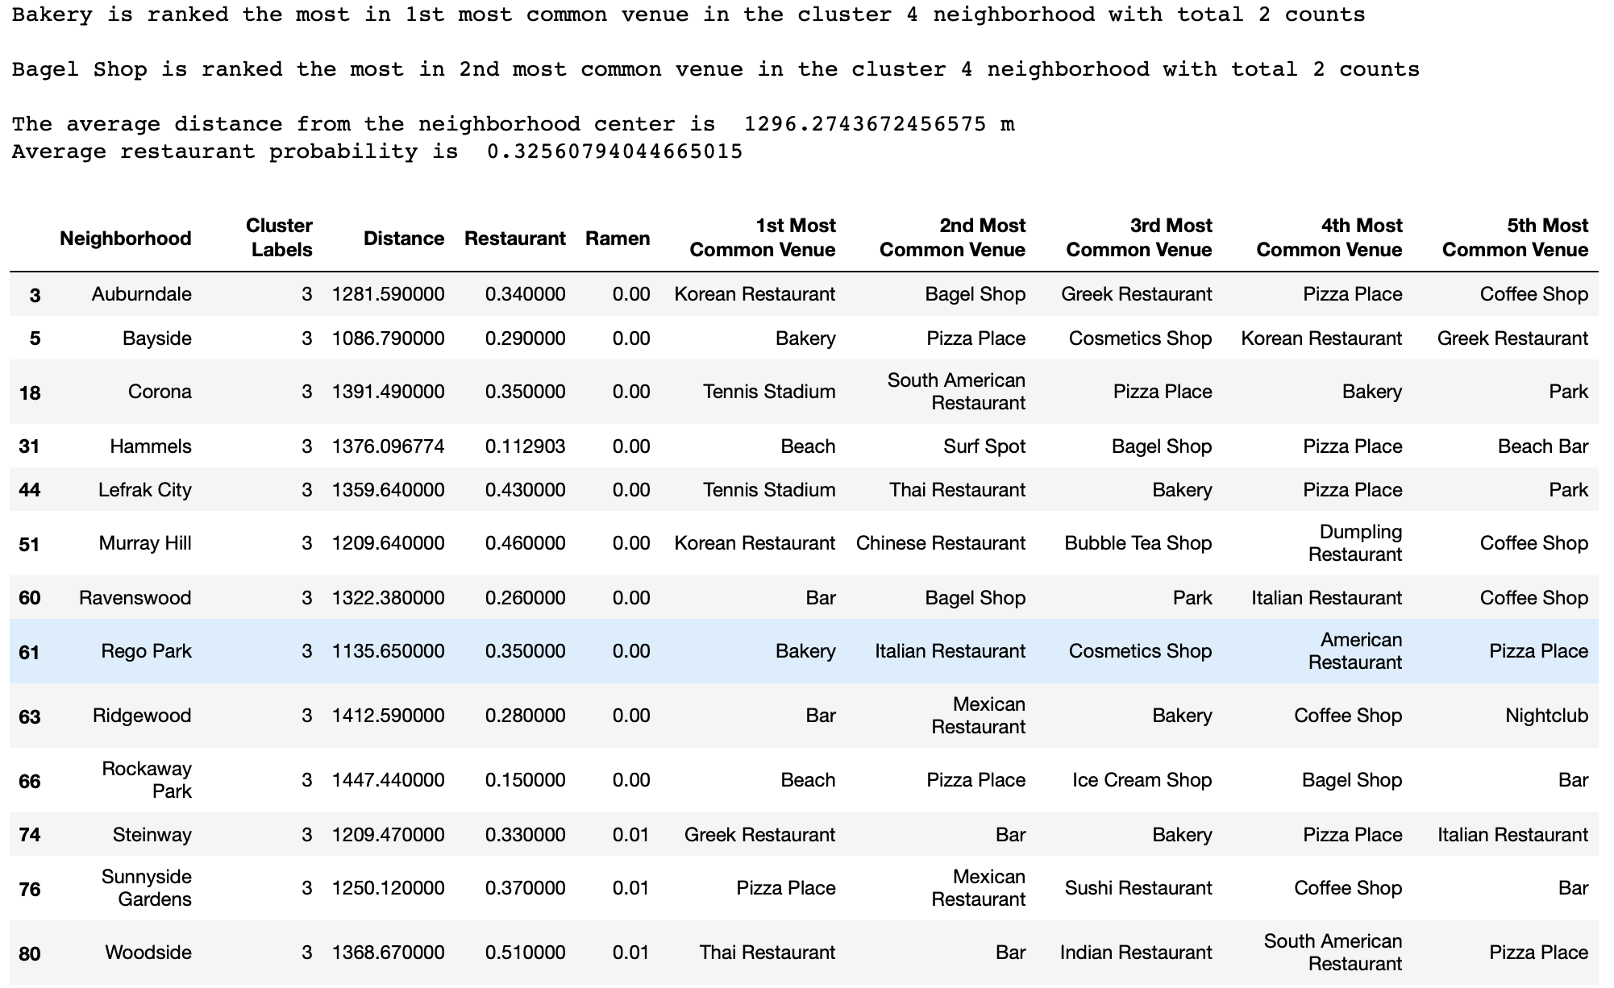
KMeans Analysis: Cluster 4 Summary

Slide 16
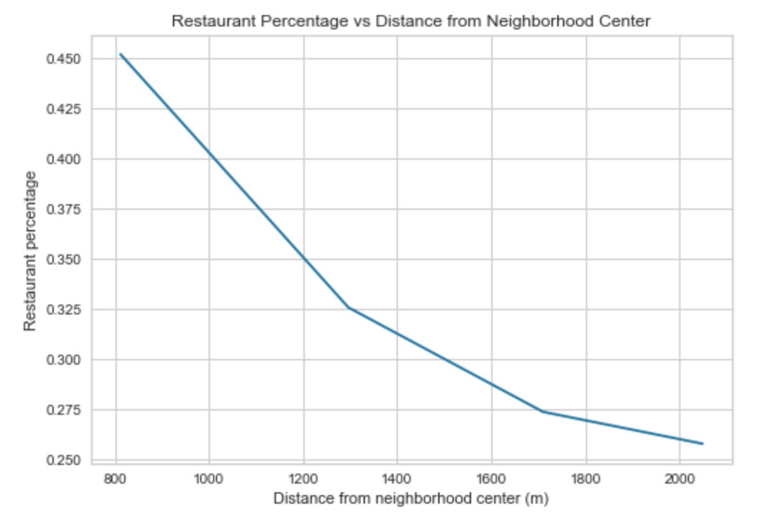
KMeans Analysis: Effect of Distance from Neighborhood Center towards Restaurant Density

Slide 17
Conclusion
Based on the exploratory analysis, the top 5 recommended venues for setting up new Ramen restaurant in Queens are Flushing, Murray Hill, Elmhurst, Woodside and Jackson Height.
Based on KMeans clustering modeling, neighborhoods in cluster 1 and cluster 4 are recommended, with the preference to be neighborhoods in cluster 1 due to its location closer to neighborhood center and higher restaurant concentration, providing higher foot traffic.
Combining exploratory analysis and KMeans modeling results, the 3 proposed neighborhoods to set up a new Ramen restaurant are Flushing, Elmhurst and Jackson Heights.

